Slide 1

© UNICEF/UNI669112/Nateel
HUMANITARIAN RESET

Slide 2
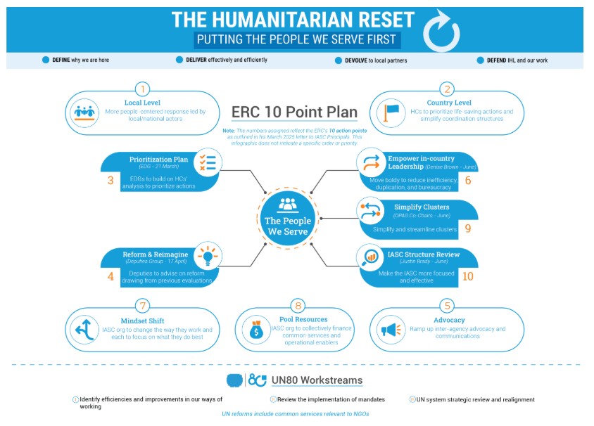

Slide 3
Cluster Reform and simplification process
Rationale
Clusters have been crucial in coordinating humanitarian efforts but are seen as being overly centralized and processed focused leading to inefficiencies.
Cluster reform aims to create a more localized, adaptive, inclusive, and impact-oriented coordination system.
Consultation process by OPAG Chairs
Global Cluster Coordinators and Cluster Lead Agencies
OPAG members
NGOs
Host Governments ( eg Niger and Somalia)
Local actors (LNA)
Donors
Humanitarian Reset Workstreams leads

Slide 4
Flexible, simplified coordination
Country-level flexibility: Humanitarian Coordinators (HCs) and Humanitarian Country Teams(HCTs) should decide if and which clusters to activate or merge based on local needs andcapacities.
Global-level streamlining: Reduce from 11 clusters and 4 AoRs to 8 clusters: Education, Food Security, Health, Land & Shelter (merging Shelter; Camp Coordination and Camp Management; Housing, Land and Property), Nutrition, Protection, Services (merging Logistics and Emergency Telecommunications) and WASH,
→AoR leads to consider seconding capacity to Protection Cluster Lead Agency to support transition from separate AoRs toone integrated Protection Cluster.
Mixed settings:
  Use clusters where appropriate in refugee contexts, ensuring refugee expertise is integrated.
  Develop joint strategies, shared analysis, tools, and coordinated delivery mechanisms, joint appeals and engagement in advocacy, policy, and programming for all affected populations

Slide 5
2. Accountable and locally led coordination
Fund
Funding access: Prioritize funding for local actors, simplify access to pooled funds, and reduce intermediaries.
Build
Build on and strengthen existing national coordination structures and systems when possible
Integrate
Unified frameworks: Integrate various people-centered strategies and existing IASC policies into a single, cohesive framework at the national level.
Co-lead
At country level, where appropriate, co-leadership with local entities (authorities/civil society) should be considered.

Slide 6
3. Operations- focused coordination
Shared services: Pool information management and leverage real-time data and automation.
Multisectoral service packages: Promote integrated planning and multi-purpose cash assistance.
Area-based coordination: Enable and Scale up local-level coordination models and link them with national structures.
Co-locate Cluster Coordinators and have them report with dotted lines to HC (matrix management).

Slide 7
4. Activation, deactivation and transition
Planned transitions: Include transition planning from the start of cluster activation, with costed plans and benchmarks.​
Use the humanitarian coordination reviews in country and the Emergency Directors’ Group Annual Review of Operations to assess/reassess the need to retain in-country clusters and transitioning ​
Performance metrics: Integrate transition progress into HC and Cluster Lead Agency evaluations.​
Sustainability: Use existing humanitarian and development funding to support capacity development and long-term transitions.
UNICEF as CLA:
Two pathways to consider are:
  transitioning to nationally owned humanitarian responses and
  moving towards early recovery phase, based on the type of crises
  For cluster transition: the process where the core functions of a cluster are either transferred to other structures or phased out. The goal is to ensure that these functions continue to be managed effectively, even after the cluster itself is no longer active
  Even after deactivation, UNICEF may continue to provide support to ensure that the transition is sustainable. This includes ongoing coordination with national and local structures and possibly providing technical assistance

