Slide 1
4.3 Implementation & Monitoring and IM Tools
INFORMATION MANAGEMENT

Slide 2
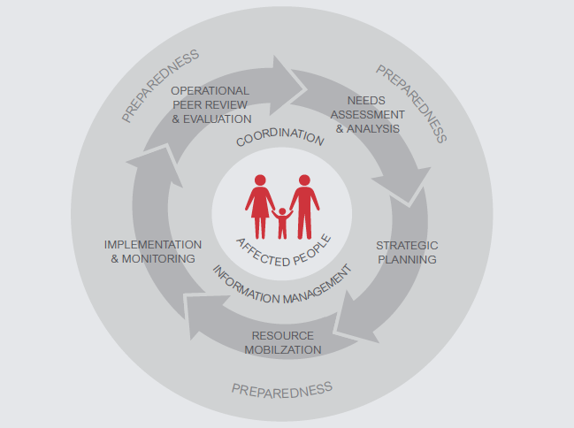
HPC

Slide 3
Monitoring is the systematic and continuous process of collecting and using information throughout the humanitarian programme cycle for management and decision-making

Slide 4
Why do we monitor?
to document progress and results against cluster targets
to provide the necessary information to cluster for timely decision taking and corrective action (if necessary)
to promote accountability to all stakeholders (to affected population, donors, partners etc)

Slide 5
Awareness Test

Slide 6
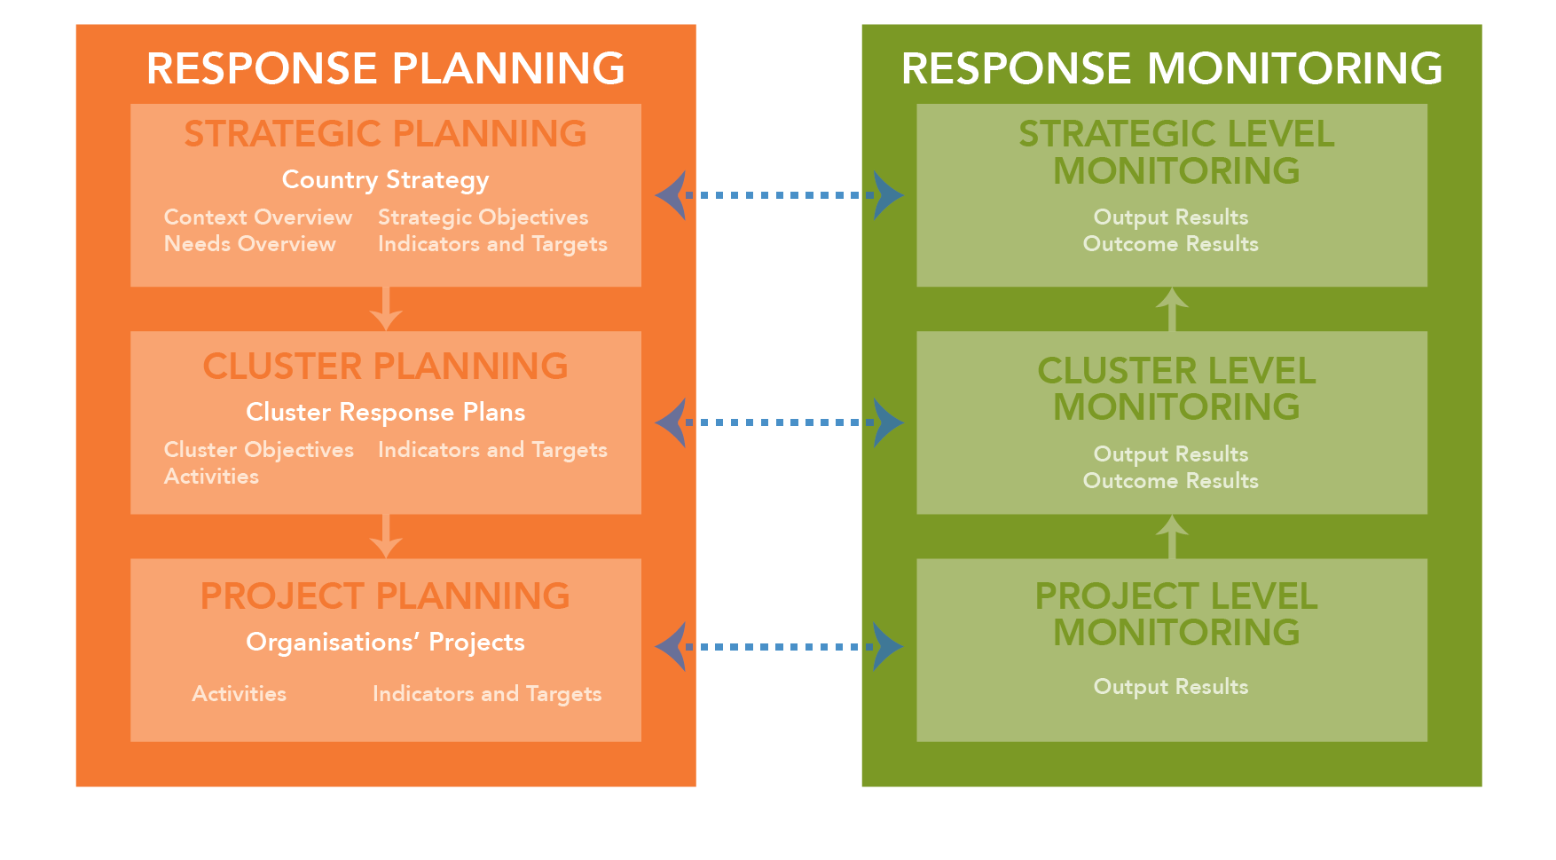
Relationship between Planning & Monitoring
Use the SAG, create a monitoring TWiG or define indicators collectively with Cluster partners!!

Slide 7
Exercise: Challenges to monitoring
Based on your experience in the nutrition cluster:
What information management processes and tools are currently being used to support monitoring?
What are three key challenges to effective response monitoring?
What could the IM do to address those challenges?

Slide 8
Common challenges
Poor linkage (situation monitoring & standard indicator)
Inadequate participation of NC partners & affected communities
Duplication
Difficulty in agreement (tools/approaches)
Corruptions and misconducts by the partners and stakeholders
Lack of capacity to address PSEA and GBV protection and prevention by the response system
Inadequate or wrong baseline data that are often gender and GBV blind

Slide 9
Acute malnutrition
A result of recent (short-term) deficiency of protein, energy, and minerals and vitamins leading to loss of body fats and muscle tissues.
Acute malnutrition presents with wasting (low weight-for-height) and/or the presence of oedema (i.e., retention of water in body tissues).

Slide 10
Severe acute malnutrition
Defined for children aged 6–59 months, as a weight-for-height below 3 standard deviations from the median weight-for-height for the standard reference population or a mid-upper arm circumference of less than 115 mm or the presence of nutritional oedema or marasmic-kwashiorkor.

Slide 11
Moderate acute malnutrition
Defined for children aged 6–59 months as weight-for-height between minus two and minus three standard deviations from the median weight-for-height for the standard reference population and no nutritional oedema or marasmic-kwashiorkor.

Slide 12
Additional data for monitoring CMAM interventions
Derived from routine monitoring and other sources:
Sources of data:
Average length of stay
Average weight gain
Relapse rate
Distribution of admissions per type, per age, per origin…
Causes of death
Reasons for defaulting
Investigation of non-recovery cases
Registration books
Individual follow up charts
Interviews and Focus group discussions
Observation, home-visits
…

Slide 13
Methods and tools for monitoring IYCF interventions
Monthly / weekly reporting:
Reporting needs to be done per site (service unit) and compiled per area (district…) up to the national level
Routine supervision
Surveys to determine situation and change in IYCF practices
BMS code violations monitoring

Slide 14
Indicators for monitoring IYCF-E interventions
Individual sessions (one-to-one) | Pregnant women attended individual counselling sessions
 | Lactating women and caretakers of children <6 months attended individual counselling sessions
 | Lactating women and caretakers of children 6-24 months attended individual counselling sessions
IYCF | Number of IYCF groups (including mother support groups) operations during the (time period)
 | Total number of group sessions (including mother support groups)held during the (time period)
 | New admission of PLW and caretakers in IYCF groups (including mother support groups during the (time period)
 | Male
 | Female
 | Total number of PLW caretakers attending IYCF groups (including mother support groups during the (time period)
 | Male
 | Female

Slide 15
Artificial feeding | Total number of infants 0-6 months require artificial feeding who have received BMS and appropriate support during the (time period)
 | Total number of infants 6-24 months who require artificial feeding you have received BMS and appropriate support during the (time period)
Breastfeeding corners/Baby friendly spaces | Total number of breastfeeding corners/baby friendly spaces opened during the (time period)
 | Number of breastfeeding corners/baby friendly spaces operational during the (time period)
 | New admissions to breastfeeding mothers during the (time period)
 | Total number of breastfeeding mothers attended breastfeeding corners/baby friendly spaces during the (time period)

Slide 16
Methods and tools for monitoring micronutrient interventions
Monthly / weekly reporting:
Reporting needs to be done per site (service unit) and compiled per area (district…) up to the national level
Surveys to determine coverage and situation
Campaign reports / administrative reports (i.e. child health days, EPI reports, etc.)

Slide 17
Indicators for monitoring micronutrient interventions
Number of boys/girls/PLW (specify age groups) received supplementation (specify) during the reporting period

Slide 18
What GNC IM Tools inform the Implementation & Monitoring stage?
Key datasets
HRP tips
4W
BMS Code Violations tracking
Partners tracking tool
Country bulletin template
HIR
IM Update template
Map examples/ templates
IM Checklist

Slide 19
What GNC IM Tools inform the Implementation & Monitoring stage?
Key datasets
HRP tips
4W
BMS Code Violations tracking
Partners reporting tool
Country bulletin template
HIR
IM Update template
Map examples/ templates
IM Checklist

Slide 20
Breast Milk Substitutes Code violations tracking tool
 | The purpose of the tool is to increase consistency in tracking code violations for improved communication and comparative analysis. Establish SEA and GBV case information sharing protocol with all relevant actors to increase response effectiveness
 | Two-part tool: An adaptable MS Word document for tracking violations of the International Code of Marketing of Breastmilk Substitutes and An MS Excel database to compile code violations for further consolidation, analysis and follow-up
 | Partners complete it initially, either in Word or Excel. Note: It is important that the identity of reporting organization’s is kept confidential. It is recommended to conduct capacity building sessions before using this tool.

Slide 21
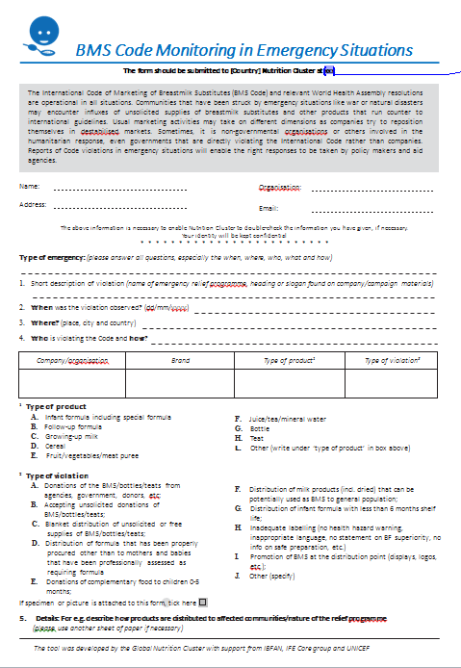
BMS Code Monitoring
Breast Milk Substitutes (BMS) are defined as: "any food being marketed or otherwise represented as partial or total replacement of breast-milk, whether or not suitable for that purpose.“
"In emergencies, targeting and use, procurement, management and distribution of BMS, milk products, bottles and teats should be strictly controlled based on technical advice, and comply with the International Code and all relevant WHA Resolutions (4)…”

Slide 22
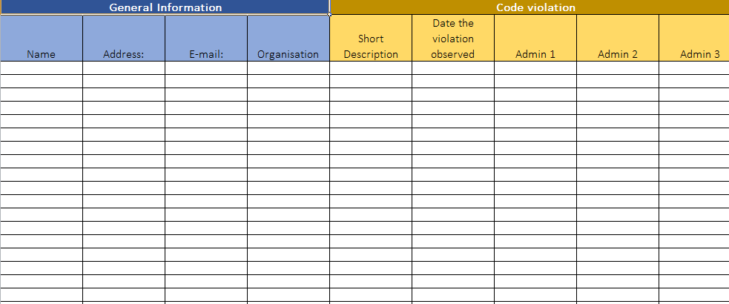
BMS Data: General Information and Code violation

Slide 23
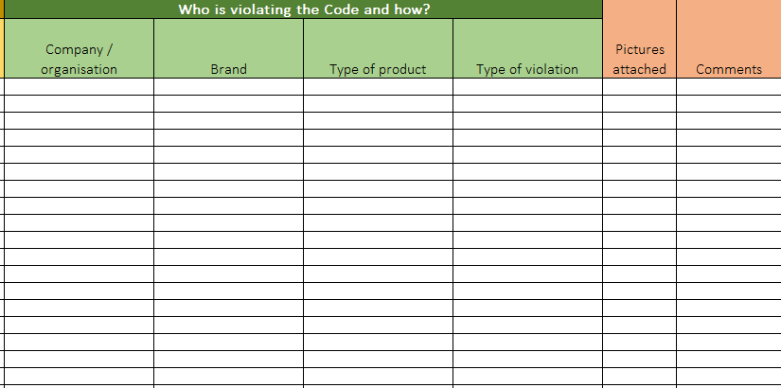
BMS data: Who is violating and how?

Slide 24
Partners reporting
INFORMATION MANAGEMENT

Slide 25
Partners reporting tool
 | An adaptable Excel template for partner reporting. The template includes various possible interventions and suggested indicators to monitor and should be adapted to the country plans.
 | Records information about nutrition services delivery including general information, screening and referrals, management of SAM (inpatient and outpatient), targeted and blanket supplementary feeding, micronutrients supplementation, deworming, IYCF-E and capacity development.
 | The tool is completed first by partners and then collated and analysed by the IMO. Users may adapt the spreadsheet by hiding row/columns that do not apply to their service provision, however the data extraction sheet should remain fixed.

Slide 26
Exercise: Partners reporting tool
Open the M&E Framework your group developed during the Strategic Planning session as the data for this exercise.
Practice completing the Partners reporting tool
20 minutes

