Slide 1
Integrated Programming
Protection

Slide 2
Session Learning Objectives
By the end of this session, participants will be able to:
Describe the role of protection in nutrition outcomes
Identify specific activities for the integration of protection (including child protection and GBV) and nutrition interventions
Notes:
Introduction
Introduce learning objectives and start with a conversation on protection. Ask participants to share what their understanding of Protection is. This definition by OCHA summarises:
“Protection encompasses all activities aimed at ensuring full respect for the rights of the individual in accordance with human rights law, international humanitarian law (which applies in situations of armed conflict) and refugee law.”

Slide 3
Notes:
This is a video. It will show when you are in presentation mode.
Introduce the concept of protection mainstreaming through showing the video (PPT 3) and PPT 4 to consolidate some key points in relation to protection mainstreaming.
Ask the group what the importance of protection is for nutrition. After some answers, ask them to form groups of 3.
Each person in the group writes down a problem related to nutrition programming in sectors, related to protection. Once done, they share their problems with the rest of the small group and discuss until they have reached a solution. This should support them to critically think of how considering protection can improve nutrition outcomes. Debrief with participants and summarise the role of protection for nutrition outcomes. Include explicit role definition and description here?

Slide 4
Protection Mainstreaming
Protection mainstreaming enables people to access and enjoy their rights within any sector program
Protection mainstreaming is defined as: “The process of incorporating protection principles and promoting meaningful access, safety and dignity in humanitarian aid.”
There are four key elements of protection mainstreaming: Prioritise safety and dignity and avoid causing harm; Meaningful Access; Accountability; and Participation and Empowerment.

Slide 5
Child Protection And Nutrition Integration
Notes:
Child Protection and Nutrition
Explain that we will zoom in on child protection. Give an entry point to the topic through outlining Standard 22 on mainstreaming child protection in nutrition, which is part of the Child Protection Minimum Standards.

Slide 6
Notes:
Trainer- These standards are being revised. Check when the new guidelines will be released. Ensure to update this session with the new guidance.

Slide 7
Standard 22: Nutrition and Child Protection
Child protection concerns are reflected in the assessment, design, monitoring and evaluation of nutrition programs.
Girls and boys of all ages and their caregivers, especially pregnant and breastfeeding women and girls, have access to safe, adequate and appropriate nutrition services and food.
Notes:
Reference Global Protection Cluster

Slide 8
Task: Key actions for Child Protection and Nutrition Actors
Notes:
Explain that there are two sides to this; considering child protection in the nutrition sector and considering nutrition within child protection.
Divide the group into four groups. Two groups will focus on Key actions for Child Protector actors and two will focus on Key Actions for Nutrition Actors. Remind participants that we are talking about nutrition outcomes. Ask the groups to think of their topic, and spend 10 minutes discussing. Then bring the groups who worked on the same team together. Give them 5 minutes to create a list based on both groups’ discussion. Allow the groups to present back to the big group and consolidate and expand. PPT 7 (Key Actions for Child Protection Actors) and PPT 8 (Key Actions for Nutrition Actors) cover basic points.

Slide 9
Key Actions for Child Protection Actors
Develop clear standard operating procedures
Consider breastfeeding needs
Consider joint programmes with the nutrition sector
Refer breastfeeding mothers who are facing difficulties producing milk
Notes:
Develop clear standard operating procedures including identification and referral mechanisms between child protection and nutritional programmes
Whenever possible, provide appropriate space for women and girls to breastfeed within or near centres where child protection and caregiver outreach programmes are carried out;
Whenever possible, run joint programmes with the nutrition sector in terms of community mobilisation, prevention messages and child-mother centres at the nutritional post (fixed or mobile), including socially and culturally appropriate, technically accurate, messages on nutrition and breastfeeding;
Refer breastfeeding mothers who are facing difficulties producing milk

Slide 10
Key Actions for Nutrition Actors
Choose a trained staff member as child protection focal point
Include child protection messages in nutrition activities
Campaign for psychosocial stimulation activities for infants and young children in nutrition, education, ECD and child protection programmes
Ensure that those working in nutrition have signed up to and been trained in a code of conduct or other policy which covers child safeguarding
Notes:
Choose at least one trained staff member to act as a child protection focal point
Include child protection messages, as well as referral mechanisms, in activities related to nutrition, community outreach and raising awareness;
Campaign for psychosocial stimulation activities for infants and young children in nutrition, education, ECD and child protection programmes
Ensure that those working in nutrition have signed up to and been trained in a code of conduct or other policy which covers child safeguarding;

Slide 11
GBV And Nutrition Integration
Notes:
Ask if anyone can explain the concept of Gender Based Violence (GBV). After having reached a consensus of the concept (also on PPT 10), show the framework on slide PPT 11 (What does GBV Integrated Nutrition Services look like?).

Slide 12
Definition
GBV is an umbrella term for any harmful act that is perpetrated against a person’s will and is based on socially ascribed (i.e. gender) differences between males and females. It includes acts that inflict physical, sexual or mental harm or suffering, threats of such actions, coercion and other deprivations of liberty.
GBV includes rape, sexual violence, physical violence, emotional violence, deprivation of opportunities and services, intimate partner violence etc.
Notes:
Core
IASC GBV guidelines definition.

Slide 13
What does GBV integrated Nutrition services look like?
Quality, Safe and accessible nutrition services
Reach to the most vulnerable populations
Safe/dignified access and use of nutrition services
Ethical nutrition services/programming
Survivor-centered GBV referral
GBV integration
Safe and meaningful participation of women, girls and other at risk groups throughout the HPC .
GBV integration is one of strategy to achieve quality, safe and accessible nutrition services. It doesn’t burden but look through the nutrition program throughout HPC from GBV lens.
Notes:
Ask them to in pairs think about these points and consider how these could link with GBV and vice versa.
Malnutrition
Access to nutrition interventions
Lack of food
Location of nutrition interventions
Carer of malnourished children
After 5-10 minutes, debrief (you can use PPT 14 – (Linkage between GBV and Nutrition) if necessary).

Slide 14
Linkage between GBV and Nutrition
GBV is one of drivers of malnutrition.
Gender/power dynamics in the home have major implications for effectiveness of nutrition interventions and uptake of the services.
Lack of food as a driver for forced marriage + increased risk of sexual exploitation and abuse.
Location and timing of nutrition services/distribution points can increase GBV risk
Caregiver’s experience of GBV can have negative implications for child nutrition outcomes
Notes:
An example from Nigeria. Women couldn’t bring her child who needs immediate overnight medical care because husband doesn’t allow. It is common in conservative areas.

Slide 15
Health/Nutrition facilities are too far/in a dangerous location.
Women and girls do not receive information because: limited to community leaders; non-child friendly
Common areas where GBV risks are present in Nutrition Sector
Barriers and enablers
Materials do not cater to the needs of the girls/women
Distribution – a long waiting line, overcrowded, lack of female distribution staffs
Participation of Women and Girls
Location of facilities
The dissemination of information and awareness
Human Resources – gender, skills, attitudes
The delivery of material support
Design/ layout of facilities – security, privacy and dignity
Social norms
Not adequate no. of female nutrition frontline workers.
Lack of female leaders in Nutrition.
Girls , boys, women and other at risk groups not consulted
systematically.
Nutrition facilities do not reflect the culture or needs of the affected population.
Notes:
Go through slide 15 (Common areas where GBV risks are present in the nutrition sector) and 16 (Integrating GBV and Nutrition – How) and elicit ideas before expanding on each area. Slide 17 supports the discussion on what GBV actors can do for nutrition outcomes, such as refer to nutrition services, capacity build nutrition workers etc.

Slide 16
Integrating GBV and Nutrition-How
Programmatic entry points
Women and girls themselves
Identify GBV risks in the environment and/or barriers to accessing services
Identify priorities
Assessment Analysis and Planning
Resource Mobilization
Implementation
Coordination
Monitoring and Evaluation
Articulate GBV risks related to your programme.
Include GBV risk mitigation measures.
Monitor GBV risks
Safety audit
Safety perception
SADD
Safe and dignified access to services.
Ethical programming.
Participation
Safe and ethical referral
Notes:
Go through slide 15 (Common areas where GBV risks are present in the nutrition sector) and 16 (Integrating GBV and Nutrition – How) and elicit ideas before expanding on each area. Slide 17 supports the discussion on what GBV actors can do for nutrition outcomes, such as refer to nutrition services, capacity build nutrition workers etc.

Slide 17
What GBV actors could do for Nutrition?
Provide space in Women friendly spaces (WFS) to for nutrition session.
Referral to Nutrition services including WFS to nutrition services.
Receive referral from Nutrition services in case of GBV disclosure.
Joint safety audit
Capacity building of nutrition frontline workers – GBV referral training.
And more! Talk to them what they are doing and what can be done together.
Notes:
Go through slide 15 (Common areas where GBV risks are present in the nutrition sector) and 16 (Integrating GBV and Nutrition – How) and elicit ideas before expanding on each area. Slide 17 supports the discussion on what GBV actors can do for nutrition outcomes, such as refer to nutrition services, capacity build nutrition workers etc.
Remember that children of GBV survivors are more likely malnourished than other children.

Slide 18
IASC GBV Guidelines – Thematic Area Guide for Nutrition
Key consideration to integrate GBV interventions in Nutrition in 5 areas:
Assessment, Analysis and Planning
Resource mobilization
Implementation
Coordination
M&E
Essential Action Sheet
Other accompanied resources:
Donor advocacy tools
Pocket guide – how to support survivors of GBV when a GBV actor is not available in your area.
https://gbvguidelines.org/wp/wp-content/uploads/2015/09/TAG-nutrition-08_26_2015.pdf
Notes:
18

Slide 19
Take Home Messages
Child protection concerns should be reflected in the assessment, design, monitoring and evaluation of nutrition programs.
Develop clear standard operating procedures including identification and referral mechanisms between child protection and nutritional programs;
Ensure that Nutrition actors are conscious about GBV risks related to nutrition program and taking measures to mitigate risks throughout the program cycle.
Integrate the considerations from the IASC GBV guidelines into nutrition minimum standards

Slide 20
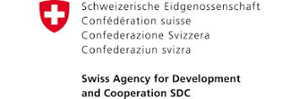
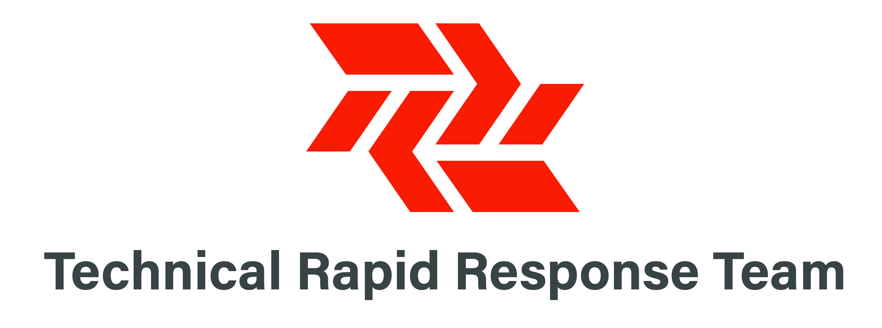
Acknowledgements
This training package was developed by the Intercluster Nutrition Working Group
This training package was funded by
This training package was developed with the technical support of

