Slide 1
Integrated Programming
Food Security

Slide 2
Learning Objectives
By the end of this session, participants will be able to:
Understand the critical role that FSL plays in nutrition outcomes
Explain the four main pathways between Agriculture/FSL and nutrition
Identify specific entry points for integrating FSL and nutrition
Notes:
Introduce the learning objectives.

Slide 3
The Four Pillars of Food Security
The availability of sufficient quantities of food of appropriate quality, supplied through domestic production or imports including food assistance.
Food availability
Access by individuals to adequate resources (entitlements, cash) for acquiring appropriate foods for a nutritious diet.
Food access
Utilization of food through adequate diet, clean water, sanitation and health care to reach a state of nutritional well-being where all physiological needs are met. This brings out the importance of non-food inputs in food security.
Food utilization
To be food secure, all individual must have access to adequate food at all times. They should not risk losing access to food as a consequence of sudden shocks (e.g. climatic crisis) or seasonal events.
Food stability
Notes:
Have four flipcharts around the room. They say Food Availability, Food Access, Food Utilization and Food Stability. Ask the participants to cluster around the flipcharts in groups, and produce a definition of each. This is a brainstorming activity and should be done quickly, don’t spend more than a couple of minutes. Once this is done, allow each group to feed back. Consolidate with PPT 3 The four Pillars of Food Security.

Slide 4
Food Security situation in X country
INADEQUATE DIETARY INTAKE
Minimum Dietary Diversity (MDD)
Minimum Meal Frequency (MMF)
Minimum Acceptable Diet (MAD)
Minimum Dietary Diversity – Women (MDD-W)
INADEQUATE ACCESS TO FOOD
The outcome of the latest IPC for Acute Food Insecurity analysis
To be adapted before training!
Notes:
PPT 2.2

Slide 5
Food Security response in X country
At household level
Conditional and Unconditional Emergency food assistance through relief food/GFA, Cash transfers or voucher transfers
TSFP to households with PLW or child admitted in CMAM program (As part of GFA)
Awareness on food utilization (preparation, storage, preservation etc.)
Production of micro-nutrient rich vegetables either through portable gardens, back yard/kitchen gardening or small plots
Restocking of small ruminants (sheep & goats)
Distribution of agricultural inputs (e.g. seeds, tools, fertilizer etc.)
Provision of concentrates/feeds, anti-parasites treatment, ice boxes etc.
Distribution of Poultry inputs (chicks, poultry feed/concentrates etc.)
Distribution of fisheries inputs - (fuel, twines, monofilaments, nets, hooks, ice boxes etc.)
To be adapted before training!
Notes:
PPT 2.2

Slide 6
Food Security response in X country (cont)
At community level
Mass livestock vaccination campaigns
Community rehabilitation and resilience activities through asset transfers e.g. cash for assets, CFW, food for assets etc.
Production of short cycle vegetables and crops through communal plots
At HF level
Training and capacity building on vegetable production and food utilization to caretakers/caregivers of children admitted in CMAM programmes
Targeted food assistance to household members of a child admitted in a stabilization centre/ DTC etc.
To be adapted before training!
Notes:
PPT 2.2

Slide 7
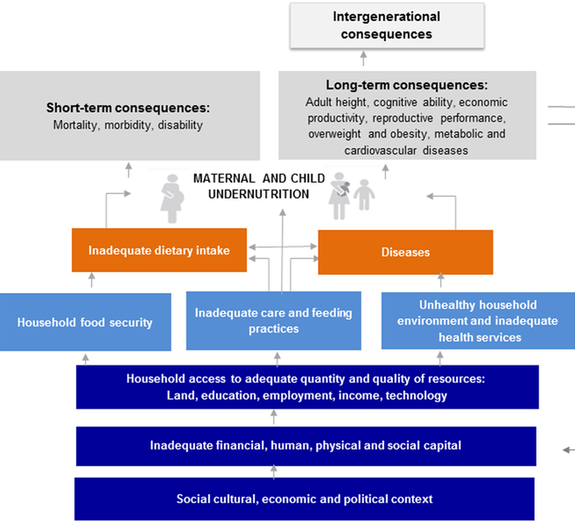
How Can FSL Improve Nutrition?
Reduce Agriculture related diseases
Production, processing, marketing, access and consumption of nutritious foods
Food availability (year round)
Income
Access (year round)
Utilization
Nutrition education
Labor saving technology
Income used for health and hygiene
Natural resource management
Source: Adapted from UNICEF
Notes:
Keep the flipcharts up, and invite the participants to come back into one big group. Ask how Food Security and livelihoods support can improve nutrition. Refer back to the discussion on the Unicef framework from yesterday and the causes the participants identified that relate to food security and livelihoods. From the discussion, elicit that there are four main pathways between FSL and nutrition:
Food Production Pathway
Income Generating Pathway
Transfer Pathway
Women’s Empowerment Pathways

Slide 8
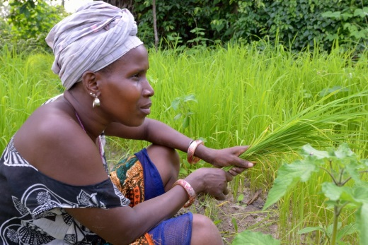
Food Production Pathway
Can supports all food security pillars.
Diversity of production can support dietary diversity.
Production diversity is also good for agriculture.
Good agricultural practices reduce soil erosion, increase organic matter, boost yields.
Poor production diversity weakens natural systems.
Notes:
Share content about the Food Production Pathway. Make sure you cover the key points:
This pathway can support all food security pillars we covered in the beginning
A diversity in food production can also support dietary diversity
Production diversity has positive impacts on agriculture
Divide the participants into groups of 5-6. Ask them each to split a flipchart into four sections, one for each pathway. Now ask them to discuss examples from the country you are in now, of the food production pathway for nutrition outcomes. Walk around the groups to ensure they are on track and discussing relevant examples. Ask the groups to share some of their discussion with the others.

Slide 9
Food Production Pathway
List examples from your country of the food production pathway for nutrition outcomes

Slide 10
Examples of Agriculture Support for Improved Nutrition
Intercropping staples with legumes enhances soil and diet diversity
Enhanced production of fruits and vegetables increases micronutrient intakes and diet diversity
Integration of small livestock and fish can increase protein intakes and diet diversity
Biofortified crops (orange sweet potato) can improve micronutrient status
Ruel et al, 2013; Webb Girard, et al., 2012
Notes:
Continue discussing the pathway through introducing the points on slide 10-11 (Examples of Agriculture Support for Improved Nutrition). Now encourage participants to make the link of nutrition activities which improve agriculture, to emphasise the link in that direction.
Ask the participants to identify examples from their country again, still within the food production pathway. Debrief and conclude by making sure the participants aware that nutrition activities can also promote agriculture and vice versa.

Slide 11
Examples of Agriculture Support for Improved Nutrition
Ensure safe animal milk supplies working closely with WASH, Nutrition, and health regarding hygienic milk product processing and storage.
Ensure initiatives act to protect recommended infant and young child feeding (IYCF) practices.
Consider complementary foods in crop selection of agriculture programmes

Slide 12
Examples of Nutrition Activities to Promote Agriculture
List examples from your country of nutrition activities that promote agriculture

Slide 13
Examples of Nutrition Activities to Promote Agriculture
Promote new high quality crops to nutrition program beneficiaries
Provide cooking demonstration using locally produced new crops in nutrition programs and involving women and men
Refer nutrition beneficiaries (families) to agriculture programs
Through nutrition education and behavior change ensure that food production is consumed at the household level and not all sold on the market, thus assisting the AgFSL sector in meeting nutrition objectives

Slide 14
Income Generation Pathway
Reliable and sustainable source of income for households. Income used for:
Food purchases (nutritious and stable diets)
Non-food purchases (health care, education)
Selected IGA activities can offer accessible nutritious food
Notes:
Ask if individuals might have an idea of what the income generating pathway is. Use PPT 14 (Income Generation Pathway) as a support), ensuring you cover:
Income generation provides a sustainable way of sourcing food and non-food purchases
Income generation activities can improve access to nutritious food

Slide 15
Examples of Income Generation Activities for improved nutrition
List examples from your country
Notes:
Let the participants go back to their groups and add examples of Income Generating Activities for improved nutrition in their country to the second section of their flipchart. Debrief and consolidate with PPT 13 and 14 (Income Generating Activities (IGA) with nutrition lens).

Slide 16
Examples of Income Generation Activities for improved nutrition
Processing of nutritious foods
Production of complementary foods for sale
Development of quality restaurants
Notes:
Before listing, ask participants for examples from SSD.
IGAs in household- such as chickens, goats, rabbits, etc. these can be kept around the homestead, do not need a lot of effort and time from the women to keep them. These animals should not roam freely in the homestead in order not to defecate where small children play or crawl in order to decrease fecal oral contamination and diseases especially diarrhea.

Slide 17
Income Generating Activities (IGA) with nutrition lens
Take into consideration women’s workload when planning activities – do no harm
Propose "breastfeeding corners" during women’s trainings, and at work
Promotion of accessible daycare systems, which can also be an IGA in itself, especially in urban zones.

Slide 18
Transfer Pathway
Source of food and cash for households. Food transfers can support:
Nutritious diets;
Stable diets.
Cash used for:
Food purchases (nutritious and stable diets)
Non-food purchases (health care, education)
Notes:
Move onto transfer pathway – ask what the difference between the previous two and this pathway could be. Elicit that the transfer pathway can consist of food and cash transfers, which support different purposes. Consolidate with PPT 18 (Transfer Pathway).

Slide 19
Examples of transfers for improved nutrition
List examples from your country
Notes:
Once participants are clear on the meaning of the pathway, invite them to complete the third box of their flipchart and come up with examples of transfers for improved nutrition. Discuss the types of transfers with support of PPTs 17-19 , connecting to the examples participants identified and through asking for examples continuously.
General Food Distributions
Food Assistance for Assets
Cash & Vouchers

Slide 20
Considerations for improved nutrition: General Food Distribution (GFD)
Deliver them within a multi-sectoral package of interventions that aims to improve food security, nutrition, health and WASH.
Enhance the nutrition-sensitivity of food transfers by improving their nutritional quality, and ensuring adequate size and timing of the transfers.
Foods that are energy, protein or micronutrient-rich, including fortified complementary foods are to be preferred.
Opt to avoid the inclusion of foods with potential negative effects for nutritional status (e.g. sugar and black tea).

Slide 21
Considerations for improved nutrition: Food Assistance for Assets (FFA)
Improve the quality of the transfer
Selecting household and community assets that address nutritional needs
Use FFA as a platform for delivering or linking to other nutritionally-relevant activities.

Slide 22
Considerations for improved nutrition: Cash & Vouchers (C&V)
Target the most vulnerable
Integrate a nutrition objective and indicators
Make sure that the amount of the transfer is sufficient to cover the cost of an adequate and nutritious diet
Empower women
Use vouchers to promote access to specific foods (improve household food diversity) or services,
Use voucher for nutrition training, education, awareness raising

Slide 23
Considerations for improved nutrition: C&V
Potential conditions include:
Nutrition-specific conditionality that addresses care, feeding, and hygiene practices that influence child nutrition and that are adapted to the context.
Health-specific conditionality addressing care-seeking behavior and practices
Agricultural-specific conditionality, promoting for instance the adoption of sustainable practices that preserves ecosystems, or new products such as orange fleshed potato.
Session 8.1: Improving impact of cash transfers on nutrition

Slide 24
Woman’s Empowerment Pathway
Women’s empowerment influences:
Use of income.
Ability to care for families.
Women’s energy expenditure.
Women who are empowered have:
More decision-making power.
Better access to, and control over, resources.
More control over time and labour allocation.
Notes:
Connect to the mentioning of women’s empowerment in the previous section on Cash and Vouchers for improved nutrition, and ask if participants can think of how this pathway functions. Ensure that you cover the key points:
Women’s empowerment has influence over aspects such as use of income, ability to care for others, energy expenditure
Women’s empowerment leads to stronger decision-making power, better access to resources and control over time

Slide 25
Examples of women’s empowerment pathway for nutrition
List examples from your country
Notes:
Ask participants to return to their final section of their flipcharts, and identify examples of Women’s Empowerment for nutrition in their context. Debrief and discuss.

Slide 26
Monitoring and Evaluation
Type | Examples
Outcome | Women’s access and control over resources
 | Availability and prices of targeted nutrient-rich foods in local markets
 | % of HH with capacity to prepare food safely (able to access food, water, fuel, cooking utensils)
 | Change in food consumption patterns
Output | Number of beneficiaries receiving agricultural inputs for diversified agriculture and livestock production
 | Number of beneficiaries complying with nutrition /health/ agriculture conditionalities
 | Total cash equivalent of targeted nutritious food redeemed through vouchers
Sources: adapted from gFSC Core Indicator Handbook and FAO Compendium of indicators for nutrition-sensitive agriculture
Notes:
TBC

Slide 27
Take Home Messages
FSL has a critical role in improving nutrition outcomes
Agriculture can support nutritious diets and vice-versa
Access to food and income can be tailored for improved nutrition related outcomes
Women’s empowerment is key in FSL and nutrition
Consider integrating nutrition-related objectives and indicators in FSL programs

Slide 28
Acknowledgements
This training package was developed by the Intercluster Nutrition Working Group
This training package was funded by
This training package was developed with the technical support of

