Slide 1
1.3 The Nutrition Cluster: Cluster Activation and Core Functions

Slide 2
Objectives of this Session
By the end of this session, participants will be able to:
Explore L3 emergencies
List the process for cluster activation and de-activation.
Describe the Cluster Core Functions with a focus on AAP and explain how they relate to the Nutrition Cluster at the country level.

Slide 3
Level 3 Emergencies
L3 emergencies are exceptional in view of their:
scale,
complexity,
urgency,
the capacity required to respond, and
the reputational risk to humanitarian organizations and responders.
Within 48 hours of a sudden-onset emergency, the IASC will determine whether it is a Level 3 emergency or not.
Notes:
Remind participants of the basics elements of the TA:
The Transformative Agenda sets out when and how clusters can be activated in different crises;
Clusters will be activated only as and when required.
Their activation will be more strategic, less automatic and time limited, and will strengthen existing national-led coordination mechanisms to the extent possible.
The Transformative Agenda also recognizes that there is no “one size fits all” approach to cluster management, and it provides various models that can be adapted for use in different contexts.
The TA focuses on how to respond collectively to a major, sudden-onset (Level 3) emergency by strengthening leadership, coordination and accountability and introducing systems, procedures and mechanisms to activate a system-wide response called ‘Humanitarian System-Wide Emergency Activation’.
L3 declraration process
The ERC and the IASC Principals meet within 48 hours of a sudden-onset emergency to assess the situation.
The decision to designate L3 is made based on five criteria: scale, urgency, complexity, capacity and reputational risk of the crisis.
The declaration of a L3 emergency will automatically activate a system-wide response.
In addition, pre-identified humanitarian leaders on stand-by will be deployed through the Inter-Agency Rapid Response Mechanism (IARRM) supported by additional OCHA capacity and technical experts to support joint needs assessment, information management, strategic planning and Flash Appeal development.

Slide 4
When is the Cluster activated?
Activation of Cluster
Gaps in coordination
Gaps in response
National authority capacity is unable to coordinate and respond to all the needs
Notes:
Questions need to be answered before activating:
Are there gaps in nutrition programming?
Is the nutrition response already being adequately managed by the national authorities?
Is there an existing and effective nutrition coordination mechanism?
Is the current and/or evolving situation beyond current capacities to address?
UNICEF is the global CLA for nutrition and has the responsibility to facilitate the discussion, analysis, and recommendation of whether a Nutrition Cluster is needed. The time for consultation is often short, and decisions are often taken by non-technical people.
The Transformative Agenda calls for cluster activation to be more strategic, less automatic and time limited.

Slide 5
Humanitarian System-wide Emergency Activation
Clusters will only be activated as and when required.
Their activation will be:
More strategic
Less automatic
Strengthen existing national-led coordination mechanisms
Time limited
In recognition of the diversity of crises, no
“one size fits all” approach to Cluster management.
Notes:
Their activation will be more strategic, less automatic and time limited, and will strengthen existing national-led coordination mechanisms to the extent possible.
In recognition of the diversity of crises, no “one size fits all” approach to cluster management.

Slide 6
Cluster De-activation
In small groups, what would be the
ideal conditions
for a Cluster to be de-activated?
Notes:
Remember: (IASC Reference Module) The criteria for cluster activation are as follows:
Trigger event in the form of a new large-scale emergency or sharp deterioration and/or significant change in an existing humanitarian situation leading to coordination gaps.
Evaluation of existing national response and coordination capacity and/or national response shows inability to appropriately meet needs.
Humanitarian needs justify a multi-sectoral approach that the existing coordination and response mechanisms can no longer adequately address.
The size of the operational presence (the number of actors and complexity of response) requires a sector-specific coordination mechanism, if this does not already exist.

Slide 7
Cluster De-activation
Same criteria is used to activate and de-activate.
De-activation if:
Remember!!!
Clusters are a temporary coordination solution!
Humanitarian situation has improved significantly (with decreased needs and reduced need for response).
National structures acquired sufficient capacity to coordinate and meet humanitarian needs.

Slide 8
Cluster Transition
!
But note that de-activation of the NC is not synonymous with stopping of humanitarian funding or activities!

Slide 9
Key Messages:
Clusters should only be activated when it can provide an added-on value to the response.
Clusters are meant to complement, not replace of overwhelm, national coordination mechanisms.
Activation of a cluster in emergency response is not automatic.
A cluster should be a time-bound initiative.
The CLA has clearly defined responsibilities.

Slide 10
Core Cluster Functions

Slide 11
Core Cluster 6 +1 Functions
AAP
Support service delivery
Inform strategic decision-making
Plan and implement cluster strategies
Monitor and evaluate performance
Build national capacity
Advocacy
Notes:
Rethink the functions and they all lean towards AAP!
All the system does is supposed to support meeting the needs of AP holistically, and clusters need always to put the specific needs in one sector into the broader perspective....

Slide 12
1. Support service delivery
Cluster Actions:
Providing a platform that ensures service delivery is driven by the Humanitarian Response Plan and strategic priorities.
Developing mechanisms to eliminate duplication of service delivery.
What does this mean?
Ensure strategic priorities are aligned to meeting affected people’s needs and priorities AND nutrition outcomes.
Mobilise capacities and resources of partners to maximise coverage and minimise gaps.
Regularly assess the context and identify changing needs, gaps and priorities.
Advocate for integration of nutrition into other cluster/sector plans and strategies.
Notes:
Concrete examples:
Identify cluster partners and establish a list of cluster partners, members and observes;
Agree on cluster objectives, roles and strategy and coordinate partners around those strategic objectives through regular meetings
Ensures that education cluster strategy, activities, etc. is not implementing in silos but in conjunction with other relevant sectors/clusters (e.g. Child Protection, WASH, Nutrition, Camp Management, etc.)
Ensure that a monitoring mechanisms (4Ws) are in place to avoid gaps, duplications, etc., and maximise coverage by cluster partners
Provide an overview of cluster partners activities, role and contributions to the cluster, etc.
Ensures that needs assessments are coordinated, do not overlap, and focus on evidence that is needed to ensure coverage, access, quality, etc.
Actively seek support to fill gaps that cannot be filled by cluster partners

Slide 13
2. Inform HC/HCT’s strategic decision-making
Cluster Actions
Prepare needs assessments and analysis of gaps to inform the setting of priorities.
Identify and find solutions for gaps, obstacles, duplication and cross-cutting issues.
Formulating priorities on the basis of analysis
What does this mean?
Ensure affected people’s needs and priorities AND nutritional needs and cross-cutting issues are included in assessment processes.
Identify existing capacities and resources, good programme practices, and advocate for additional resources to minimise gaps.
Ensure that response priorities address affected people’s needs and intervention strategies are relevant and appropriate to the context.
Notes:
Concrete examples:
Identify cluster partners and establish a list of cluster partners, members and observes;
Agree on cluster objectives, roles and strategy and coordinate partners around those strategic objectives through regular meetings
Ensures that education cluster strategy, activities, etc. is not implementing in silos but in conjunction with other relevant sectors/clusters (e.g. Child Protection, WASH, Nutrition, Camp Management, etc.)
Ensure that a monitoring mechanisms (4Ws) are in place to avoid gaps, duplications, etc., and maximise coverage by cluster partners
Provide an overview of cluster partners activities, role and contributions to the cluster, etc.
Ensures that needs assessments are coordinated, do not overlap, and focus on evidence that is needed to ensure coverage, access, quality, etc.
Actively seek support to fill gaps that cannot be filled by cluster partners

Slide 14
3. Plan and implement cluster strategies
Cluster Actions
Develop sectoral plans, objectives and indicators to support the overall response’s strategic objectives.
Apply and adhere to common standards and guidelines.
Clarify funding requirements, helping to set priorities, and agreeing cluster contributions to the HC’s overall humanitarian funding proposals.
What does this mean?
Ensure affected people’s needs and nutrition outcomes are reflected in plans, objectives and indicators.
Promote and build capacity of partners to apply relevant nutrition and quality and accountability standards (like the CHS).
Consider ways to monitor and promote technical quality, accountability and support to local capacity building in funding criteria.
Advocate for integration of nutrition criteria and activities into other cluster/sector plans and funding requirements.
Notes:
Concrete examples:
Identify cluster partners and establish a list of cluster partners, members and observes;
Agree on cluster objectives, roles and strategy and coordinate partners around those strategic objectives through regular meetings
Ensures that education cluster strategy, activities, etc. is not implementing in silos but in conjunction with other relevant sectors/clusters (e.g. Child Protection, WASH, Nutrition, Camp Management, etc.)
Ensure that a monitoring mechanisms (4Ws) are in place to avoid gaps, duplications, etc., and maximise coverage by cluster partners
Provide an overview of cluster partners activities, role and contributions to the cluster, etc.
Ensures that needs assessments are coordinated, do not overlap, and focus on evidence that is needed to ensure coverage, access, quality, etc.
Actively seek support to fill gaps that cannot be filled by cluster partners

Slide 15
4. Monitor and evaluate performance
Cluster Actions
Monitoring and reporting on activities and needs.
Measuring progress against the cluster strategy and agreed results.
Recommending corrective action where necessary
What does this mean?
Promoting joint approaches to monitoring and reporting on quality and accountability, including feedback from communities.
Identifying and regularly discussing gaps, quality, consistency, protection, access, and feedback from local partners and affected people.
Collecting, analysing and consolidating monitoring data, and informing partners, other clusters and HCT.
Inform other clusters, HCT, donors and other actors on major issues and provide regular feedback to partners and communities on how their concerns are being addressed.
Regularly discuss how well the cluster is working in meeting its coordination functions.
Notes:
Concrete examples:
Identify cluster partners and establish a list of cluster partners, members and observes;
Agree on cluster objectives, roles and strategy and coordinate partners around those strategic objectives through regular meetings
Ensures that education cluster strategy, activities, etc. is not implementing in silos but in conjunction with other relevant sectors/clusters (e.g. Child Protection, WASH, Nutrition, Camp Management, etc.)
Ensure that a monitoring mechanisms (4Ws) are in place to avoid gaps, duplications, etc., and maximise coverage by cluster partners
Provide an overview of cluster partners activities, role and contributions to the cluster, etc.
Ensures that needs assessments are coordinated, do not overlap, and focus on evidence that is needed to ensure coverage, access, quality, etc.
Actively seek support to fill gaps that cannot be filled by cluster partners

Slide 16
5. Build national capacity in preparedness and contingency planning
Cluster Actions
In preparing for and responding to an emergency, international humanitarian actors are expected to cooperate with national authorities and support national capacity wherever it is feasible and appropriate to do so.
What does this mean?
Map local capacities and identify gaps prior to a crisis and as part of needs assessments processes
Encourage partners to share resources, peer-to-peer learning, and other forms of capacity development of local actors.
Regularly consult with local actors on their immediate and long-term needs and priorities
Advocate for funding and support for local partners and actors.
Notes:
Concrete examples:
Identify cluster partners and establish a list of cluster partners, members and observes;
Agree on cluster objectives, roles and strategy and coordinate partners around those strategic objectives through regular meetings
Ensures that education cluster strategy, activities, etc. is not implementing in silos but in conjunction with other relevant sectors/clusters (e.g. Child Protection, WASH, Nutrition, Camp Management, etc.)
Ensure that a monitoring mechanisms (4Ws) are in place to avoid gaps, duplications, etc., and maximise coverage by cluster partners
Provide an overview of cluster partners activities, role and contributions to the cluster, etc.
Ensures that needs assessments are coordinated, do not overlap, and focus on evidence that is needed to ensure coverage, access, quality, etc.
Actively seek support to fill gaps that cannot be filled by cluster partners

Slide 17
6. Support robust advocacy
Cluster Actions
Identifying concerns, and contributing key information and messages to HC and HCT messaging and action.
Undertaking advocacy on behalf of the cluster, cluster members, and affected people.
What does this mean?
Advocate for support and resources to ensure engagement of affected people in all aspects of the response.
Use monitoring data and information from cluster partners, communities and local actors to identify advocacy issues.
Ensure affected communities views and perspectives are fairly and accurately represented in any advocacy activities.
Advocate within the cluster and at the inter-cluster level on integrating affected people’s concerns into response plans and strategies.
Advocate on behalf of the cluster for integration of nutrition issues at the inter-cluster and HCT level, and with other stakeholders like donors.
Notes:
Concrete examples:
Identify cluster partners and establish a list of cluster partners, members and observes;
Agree on cluster objectives, roles and strategy and coordinate partners around those strategic objectives through regular meetings
Ensures that education cluster strategy, activities, etc. is not implementing in silos but in conjunction with other relevant sectors/clusters (e.g. Child Protection, WASH, Nutrition, Camp Management, etc.)
Ensure that a monitoring mechanisms (4Ws) are in place to avoid gaps, duplications, etc., and maximise coverage by cluster partners
Provide an overview of cluster partners activities, role and contributions to the cluster, etc.
Ensures that needs assessments are coordinated, do not overlap, and focus on evidence that is needed to ensure coverage, access, quality, etc.
Actively seek support to fill gaps that cannot be filled by cluster partners

Slide 18
+ Accountability to Affected People
Cluster Actions
Mechanisms to consult and involve affected people in decision-making agreed upon and used by partners
Mechanisms to receive, investigate and act upon complaints on the assistance received agreed upon and used by partners
Key issues relating to PSEA have been raised and discussed
What does this mean?
Review and assess cluster partners’ capacities to implement complaints and feedback mechanisms
Promote common approaches to engaging with communities, including joint feedback and complaints mechanisms.
Ensure that all cluster partners are aware of and know procedures for dealing with sensitive issues and complaints, including PSEA.
Promote regular discussions of feedback from affected people and ensure any actions or decisions are shared back to communities.
Notes:
Concrete examples:
Identify cluster partners and establish a list of cluster partners, members and observes;
Agree on cluster objectives, roles and strategy and coordinate partners around those strategic objectives through regular meetings
Ensures that education cluster strategy, activities, etc. is not implementing in silos but in conjunction with other relevant sectors/clusters (e.g. Child Protection, WASH, Nutrition, Camp Management, etc.)
Ensure that a monitoring mechanisms (4Ws) are in place to avoid gaps, duplications, etc., and maximise coverage by cluster partners
Provide an overview of cluster partners activities, role and contributions to the cluster, etc.
Ensures that needs assessments are coordinated, do not overlap, and focus on evidence that is needed to ensure coverage, access, quality, etc.
Actively seek support to fill gaps that cannot be filled by cluster partners

Slide 19
All this contributes to responses that…
Are appropriate and relevant
Are timely and effective
Strengthen local capacities and avoid negative effects
Are based on communication, participation and feedback
Provide safe and accessible complaints and response mechanisms
Are coordinated and complementary
Support continuous learning and improvements
Are delivered by competent staff
Use resources efficiently and effectively
Notes:
Concrete examples:
Identify cluster partners and establish a list of cluster partners, members and observes;
Agree on cluster objectives, roles and strategy and coordinate partners around those strategic objectives through regular meetings
Ensures that education cluster strategy, activities, etc. is not implementing in silos but in conjunction with other relevant sectors/clusters (e.g. Child Protection, WASH, Nutrition, Camp Management, etc.)
Ensure that a monitoring mechanisms (4Ws) are in place to avoid gaps, duplications, etc., and maximise coverage by cluster partners
Provide an overview of cluster partners activities, role and contributions to the cluster, etc.
Ensures that needs assessments are coordinated, do not overlap, and focus on evidence that is needed to ensure coverage, access, quality, etc.
Actively seek support to fill gaps that cannot be filled by cluster partners

Slide 20
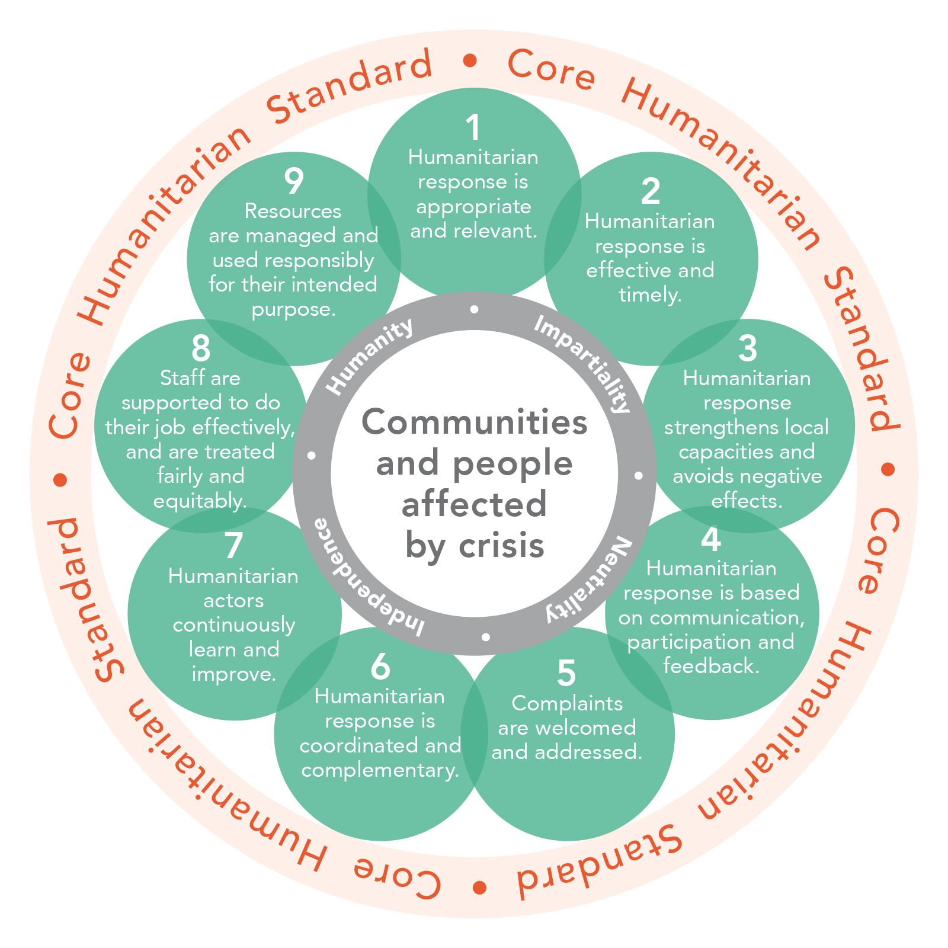
And the CHS commitments
Notes:
Concrete examples:
Identify cluster partners and establish a list of cluster partners, members and observes;
Agree on cluster objectives, roles and strategy and coordinate partners around those strategic objectives through regular meetings
Ensures that education cluster strategy, activities, etc. is not implementing in silos but in conjunction with other relevant sectors/clusters (e.g. Child Protection, WASH, Nutrition, Camp Management, etc.)
Ensure that a monitoring mechanisms (4Ws) are in place to avoid gaps, duplications, etc., and maximise coverage by cluster partners
Provide an overview of cluster partners activities, role and contributions to the cluster, etc.
Ensures that needs assessments are coordinated, do not overlap, and focus on evidence that is needed to ensure coverage, access, quality, etc.
Actively seek support to fill gaps that cannot be filled by cluster partners

Slide 21
Key Messages:
Cluster Core Functions revolve around supporting better outcomes and accountability to affected people
The core functions help ensure partners align their work towards collective and coordinated approaches
The functions form the basis of how a cluster works together, and include issues beyond implementation

